Slide 1
Assistive Devices to Support Invisible Disabilities
Jennifer Cunningham, OTR/L, ATP
Occupational Therapist
Assistive Technology Professional
VP of Client Services
jennifer.cunningham@star-center.org

Slide 2
What is an “invisible disability?”
any physical, mental, or emotional impairment that goes largely unnoticed
May also be referred to
Non-visible
Hidden
Non-apparent
Unseen

Slide 3
Examples?
Attention Deficit Disorder (ADD)
Anxiety
Depression
Post-traumatic Stress Disorder (PTSD)
Specific Learning Disorders
Brain Injury
Deaf/Hard of Hearing
Blindness/Low Vision
Autism Spectrum Disorder (ASD)
Chronic Fatigue
Chronic Pain

Slide 4
Assistive Technology
Assistive technology (AT) is an umbrella term for low tech or high tech items that help to maintain or improve an individual’s functional independence.
Assistive technology can be used in the classroom, workplace, home, or community.
Hearing aids, wheelchairs, communication aids, magnifiers, and memory aids are all examples of assistive technology.

Slide 5
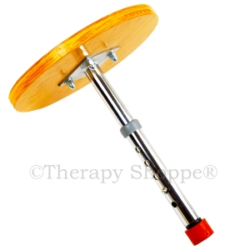
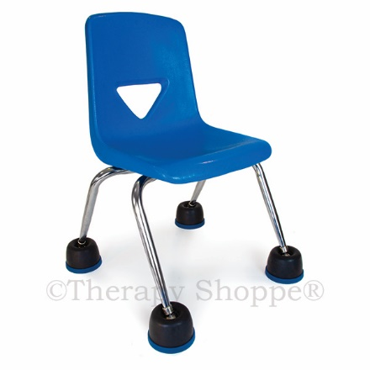
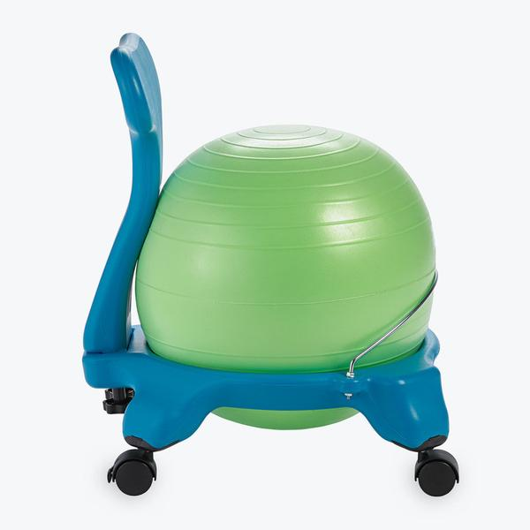
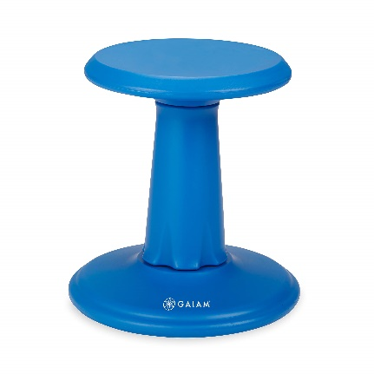
Alternative Seating

Slide 6
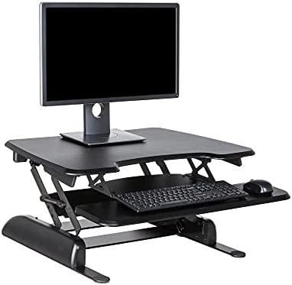
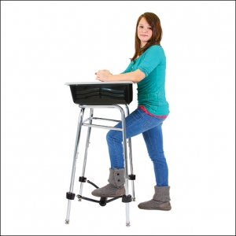
Standing Desks
Desk Converter Kit
Can be added to any standard school desk
Raise the height 16” – 23”
Does not accommodate sit to stand seamlessly
Varidesk Converter
Can sit on top of any surface
Pneumatic lift
Easily convert from sit to stand

Slide 7
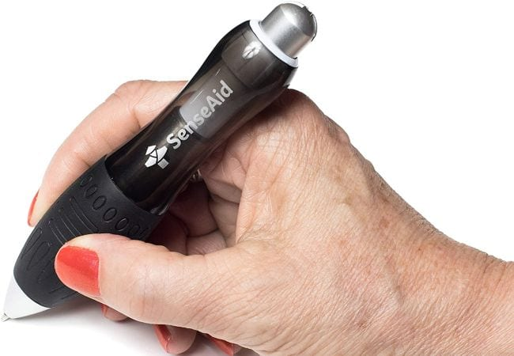
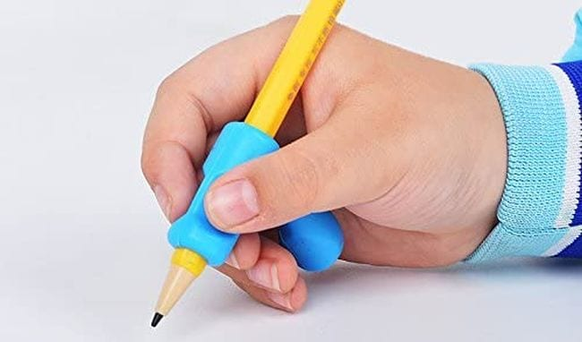
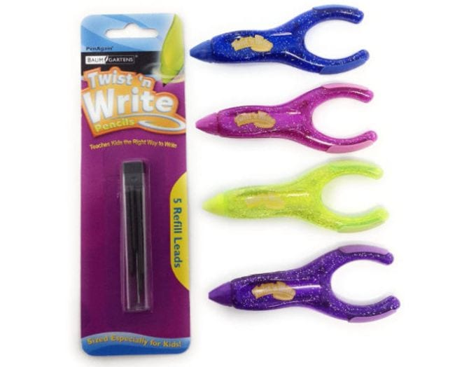
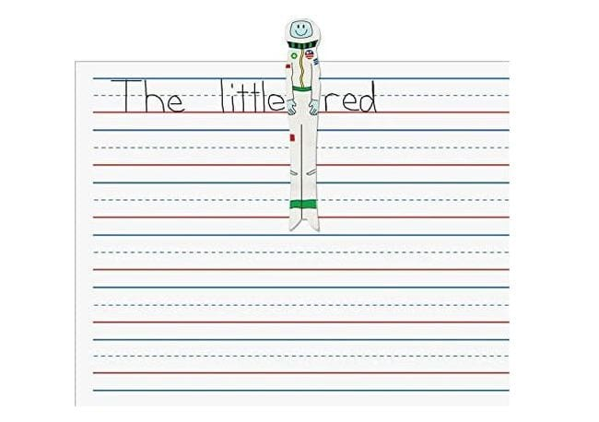
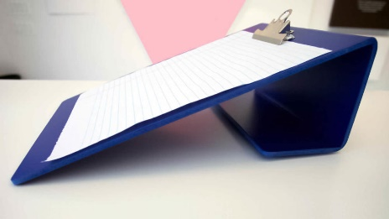
Writing Devices
Notes:
Spacing Aids
Pencil grips (elephant, ergonomic, Handiwriter)
All support open web positioning and proper grasp
Alternative types of devices (weighted; alternative grasp)
Other (wipeable writing and tracing; magnetic let writing, slant board)

Slide 8
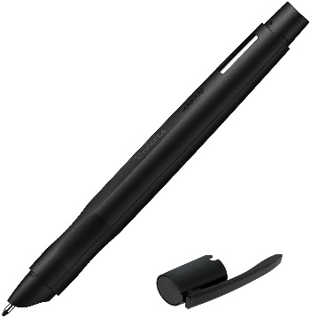
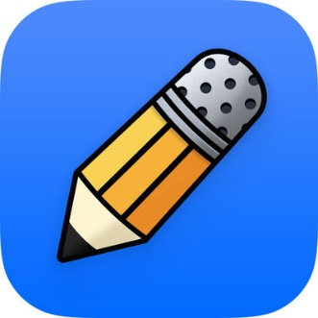
Note Taking
Livescribe Echo 2
Records audio in conjunction with handwritten notes
Connects to computer/smart device via Bluetooth or USB-C connection
Provides tactile (writing), audio (recording), and visual (colored digital) support
Supported by Windows, MacOS, iOS/iPadOS, Android, and ChromeOS
Notability
Digital notetaking option
Supports handwriting with a digital stylus or typing
Will record audio in conjunction with notes
Supported by iOS/iPadOS
Similar apps for Android

Slide 9
Reading
C-PEN ReaderPen
OrCam Read

Slide 10
Digital Content Audio Feedback
Natural Reader
Speechify
Spoken Content (MacOS, iOS, iPadOS)
Lookout (Android)
Windows Magnifier/Reader
Learning Ally (digital books)

Slide 11
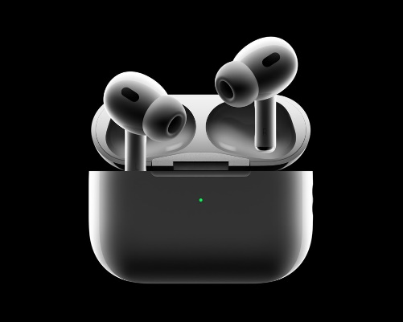
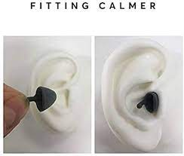
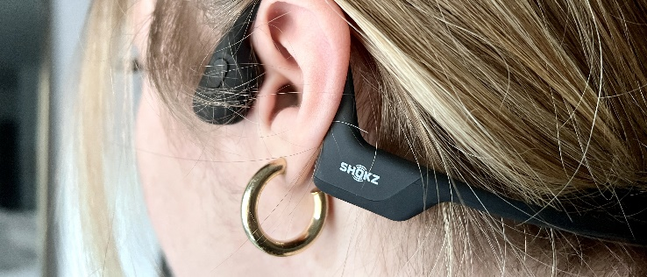
Audio and Sensory Support
Notes:
Calmer Pro: Reduces noise related stress & sensory overwhelm - without isolating you from sounds you want to hear.
Very helpful for those with: sensitive hearing, hyper-sensitivity to sound associated with autism, hyperacusis, misophonia, noise related stress & other hearing conditions.
Loop Experience Pro earplugs reduce noise by 18 decibels evenly across low, mid and high frequencies. By combining an acoustic channel, membrane and filter it provides the most high fidelity attenuation. Mute accessory adds 5 extra decibels of noise blockage.

Slide 12
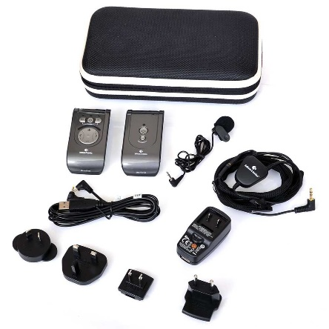
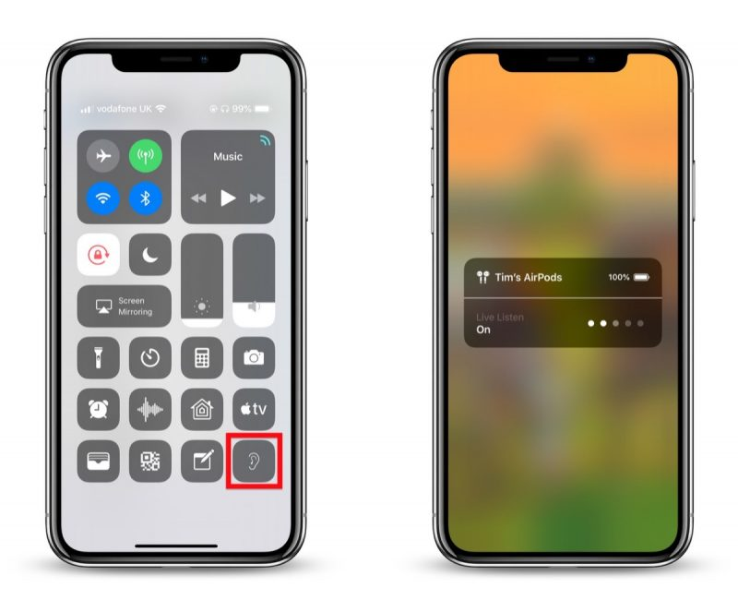
Hearing Loss Support
Live Listening
Live Transcribe
Ava
FM Amplifying Systems
Notes:
Live Listening – iOS; works with several versions of AirPods and with Beats; turns phone into amplifying device
Live Captioning – AI captioning available in most virtual platforms, Android, and newly added to iOS 16
Ava – AI Captioning application; can be paired with other devices running the application to increase captioning range
FM Systems (Bellman & Symfon Domino Pro) – use radio frequency, microphones, and transmitters to increase the direct sound to the user

Slide 13
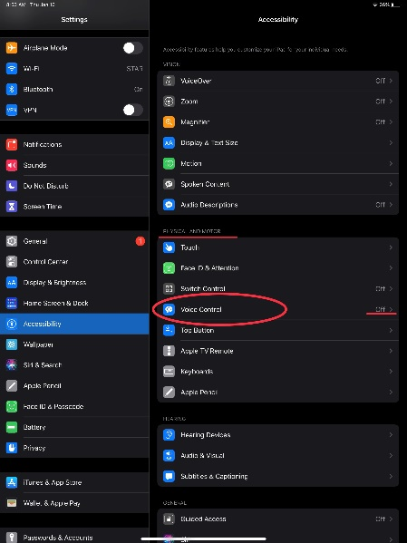
Speech-to-Text
Dragon NaturallySpeaking
Voice Control
Dictation
iOS/iPadOS/MacOS
Microsoft 365 Word
Android
Braina

Slide 14
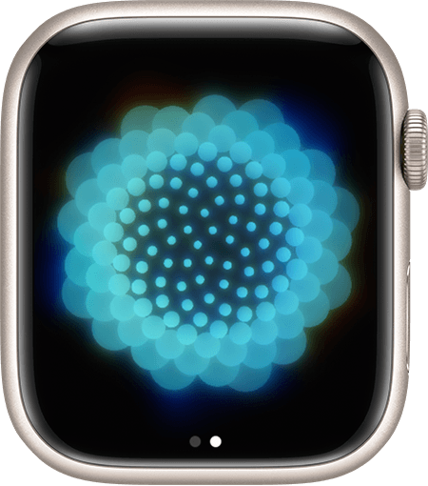
Mindfulness and Grounding

Slide 15
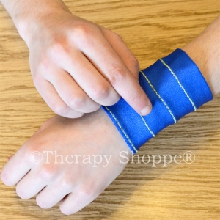
Anxiety Reduction: Weight and Compression

Slide 16
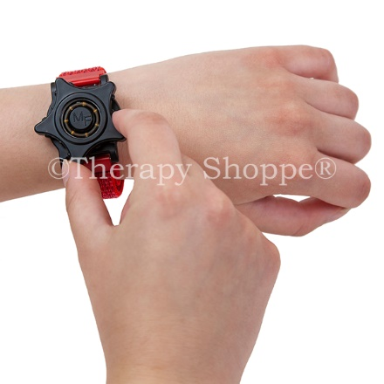
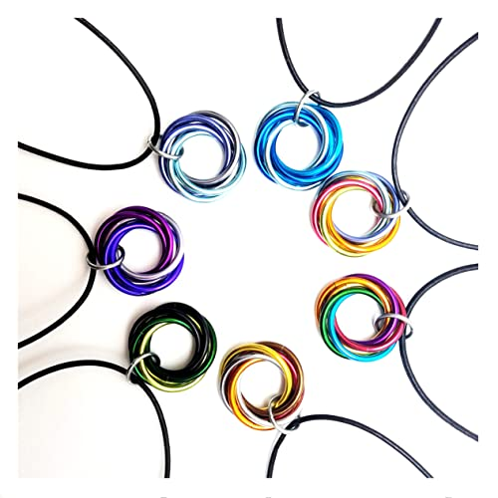
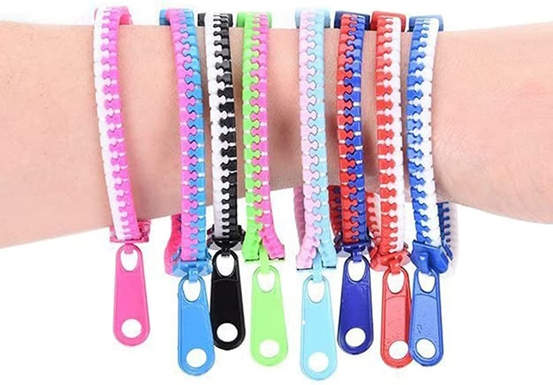
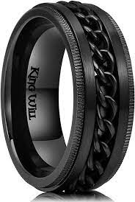
Anxiety Reduction: Fidgety Jewelry

Slide 17
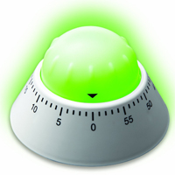
Visualization
Notes:
Visual Timers (physical or app)
Streaks
Clear To-dos
Visual Planner

Slide 19
The mission of The STAR Center is to help any person with any disability to realize their potential. We provide services for education, employment, and quality of life for all ages and needs.
info@star-center.org
1-800-464-5619

